Slide 1
Butterflies? Anxiety? Sweat?
How to give your best interview
Notes:
I am not here to talk to you about first dates, I am here to talk to you about the interview.

Slide 2

two way communication
Notes:
Many people aren’t sure which is worse, but the striking similarity should be one key element: two way communication.
Often, we think of the interview as an authority figure drilling questions at us as we try to dodge and manage an articulate response. In my opinion, an effective interviewee is one that does not quickly respond, rather takes their time, responds, and at an advanced level, uses that question as an opportunity to share something they are proud of or to ask a question.

Slide 3
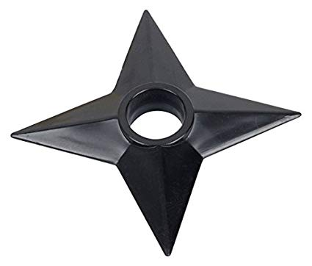
The Star method
Star Method
S – Situation
T – Task
A – Action
R – Results
Star, Ninja
Notes:
Before I get ahead of myself, let me start with the basic structure of answering a behavioural question like: Tell me about a time when….
What is key to this method is the ability to outline what you did, how you did it, and provide information on the ultimate result in an organized way.

Slide 4

Types of questions
Behavioural
Situational
Notes:
There are many great tips on how to manage different types of interview questions, which can depend on the industry and type of position. However a big portion of understanding what might come your way is knowing the types of questions. For instance, a behavioural question like the one above (tell me about a time when)…. versus a situational one (here is a situation that often happens at our organization, tell us how you will handle it). These can be found in most introductory HR texts or even through a simple Google search.

Slide 5

authenticity
An interview works both ways. You are both sharing signals.
Notes:
York University was on strike and I needed a job so I applied to work in a clothing store despite disliking fashion. When the interviewer asked me how I kept up with trends and what colour was in season, I lied and then I guessed royal purple. Surprisingly, I got the job and (unsurprisingly) I hated it. I’ve since learned not to lie in interviews.
A larger lesson cam later in life when I was starting my career. When I received an interview for a labour relations position, I was ecstatic… and a little sick to my stomach. I sat down to interview with the Director of Labour Relations, and I was feeling pretty good about how it was going…. until in the middle of a question I said something pro-union. The director looked at me, and said, “I hope that is not to say you are pro-union?”
She was clearly displeased with my position. Instead of playing it smart, I responded, “I hope that is not a problem, otherwise this job probably isn’t for me.” It went downhill from there. I had subsequent interviews with the VP, and was grilled accordingly.
To my surprise, I got that job, and it launched my career in Labour Relations. Turns out, they wanted someone who was not afraid of holding strong in their position. Let me tell you, that may be the toughest job I have ever had. This experience taught me two things.
1. I got the job by being myself.
2. That interview should have been an indicator to me that this was a rough n’ tough, wild west environment.

Slide 6

Closing
Take control
Ask tough questions
Read the signals
Notes:
Lastly, let’s spend some time on how to properly close. The end of the interview is where you can take control. If you feel like the interviewers do not feel you meet the qualifications, this is your chance to convince them otherwise. You absolutely can ask tough questions! For instance, what skill does your ideal candidate have that I have not showcased here today? What is your ideal candidate? Who are you hoping to find in this process? You can create opportunities to further solidify that you are the right candidate. These questions are powerful – they create an opportunity for you to determine if the job is right for you and this is the chance to prove it.
Remember, an interview is not the opportunity for an authority figure to drown you in questions – control it and read the signals.

Slide 7
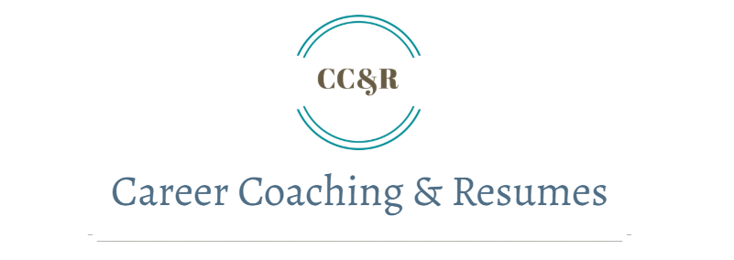
Thank you
Reach out if you are interested in more HR content.
To find this presentation in more detail, you can visit my HR blog at: www.ccandrconsulting.ca

